Slide 1


Welcome to Year 5

Slide 2
The Year 5 Team
Mrs Woodman
Mrs Rand
Mrs Crouch
Mrs Bailey
Mrs Muchell
Ms Crabbe

Slide 3
What’s different?
  New building
  New gate entrance from the park
  Earlier finish time – 3.15pm
  Increased independence and responsibilities
  Personal equipment
  SATs

Slide 4
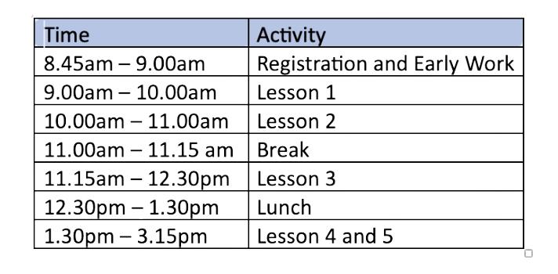
Year 5 Daily Timetable
New Fluency sessions for Reading and Maths

Slide 5
Homework
  Building independent learning skills
  Consolidating learning in class
  Revision
  Set on Google Classrooms
  Weekly spellings
  Maths fluency
  One piece of Maths and English homework every week.
  Continue to read with your children
  Homework Club

Slide 6
Equipment
and
Resources
  Small pencil case
  Water bottle
  Reading book

Slide 7
Mobile Phones
  Only if walking to and from school
  No Smart watches
  To be switched off and given to the class teacher for safe keeping
  Avoid access to social media (most have age restrictions for a reason)
https://www.nspcc.org.uk/keeping-children-safe/online-safety/

Slide 8
Assessment
  No statutory assessments in Year 5
  Weekly spelling and timestables tests
  Short end of unit tests
  Termly assessments
  SATS - end of Year 6

Slide 9
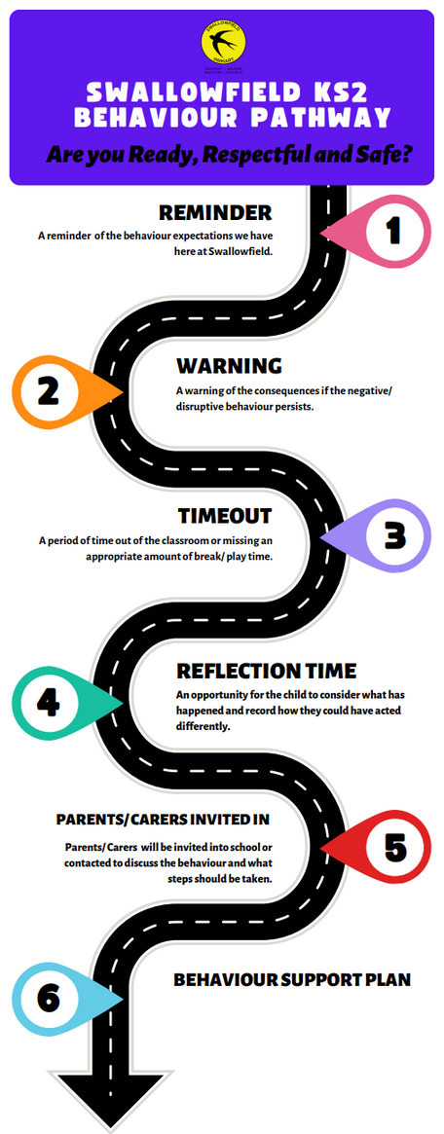
Behaviour Pathway

Slide 10
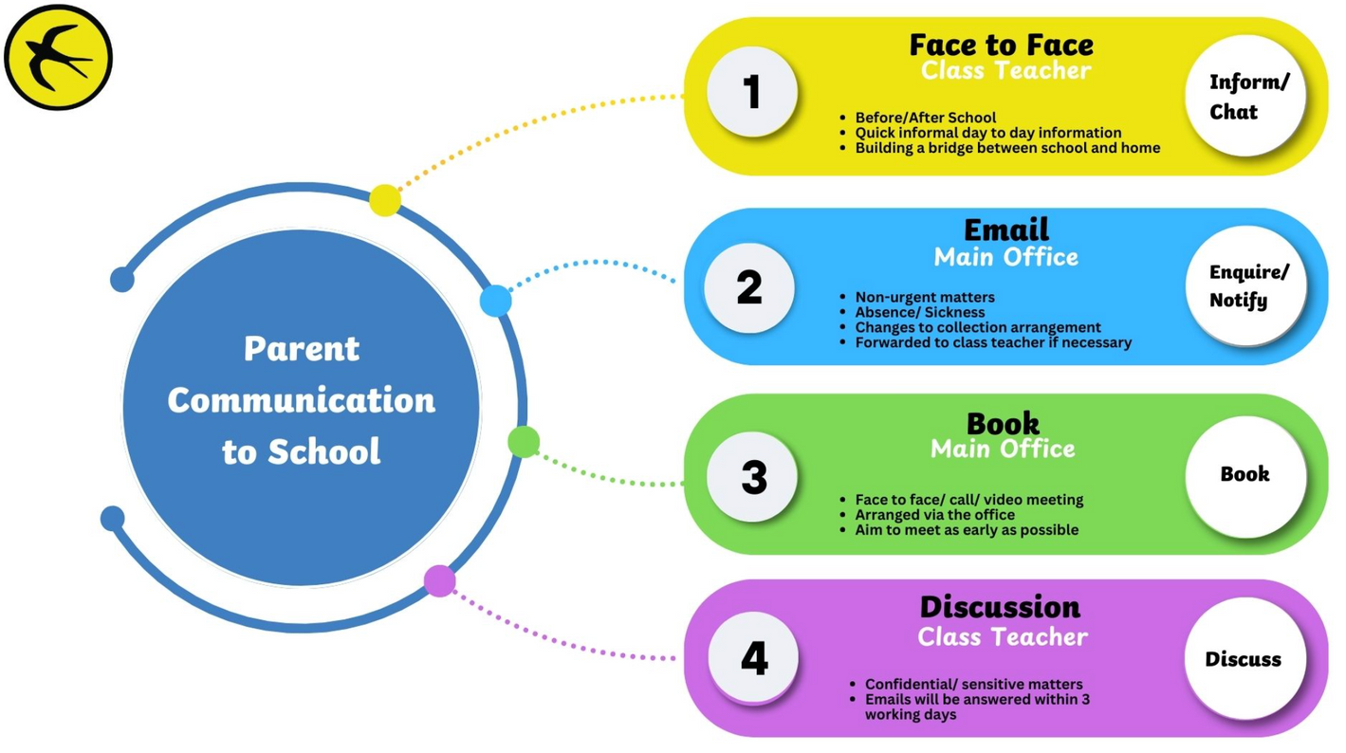
Communication

Slide 11
Forthcoming Events
  Macmillan Coffee afternoon
  Space Museum
  Consultations
  Christmas Production
  Greek Day
  Level 2 Bikeability
  Hazard Alley

Slide 12
Questions?

Slide 13
Thank you and we look forward to working with you.

