Slide 1


Welcome to Year 5

Slide 2
The Year 5 Team
Mrs Woodman
Mrs Rand
Mrs Miller
Mrs Scouller
Mrs Muchell
Ms Crabbe

Slide 3
What’s different?
New building
New gate entrance from the park
Earlier finish time – 3.15pm
Increased independence and responsibilities
Personal equipment
SATs

Slide 4
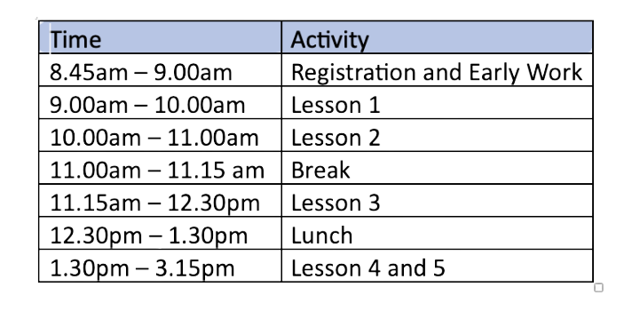
Year 5 Daily Timetable

Slide 5
Homework
Building independent learning skills
Consolidating learning in class
Revision
Set on Google Classrooms
Weekly spellings
Maths fluency
One piece of maths and written homework every week.
Homework Club

Slide 6
Equipment
and
Resources
Small pencil case
Water bottle
Reading book

Slide 7
Mobile Phones
Only if walking to and from school
To be switched off and given to the class teacher for safe keeping
Avoid access to social media (most have age restrictions for a reason)
https://www.nspcc.org.uk/keeping-children-safe/online-safety/

Slide 8
Assessment
No statutory assessments in Year 5
Weekly spelling and timestables tests
Short end of unit tests
Termly assessments
SATS - end of Year 6

Slide 9
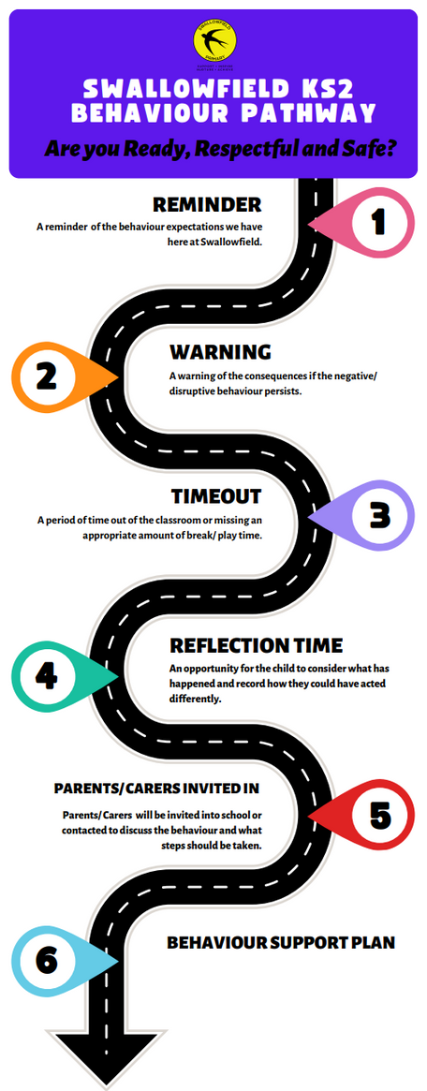
Behaviour Pathway

Slide 10
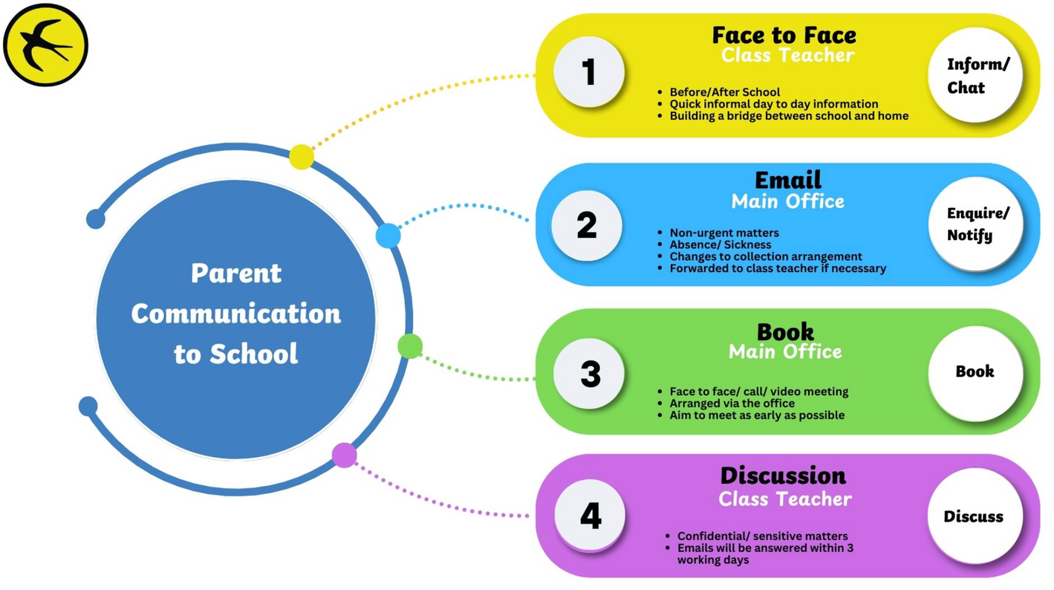
Communication

Slide 11
Forthcoming Events
Macmillan Coffee afternoon
Space Museum
Consultations
Christmas Production
Greek Day
Hazard Alley

Slide 12
Questions?

Slide 13
Thank you and we look forward to working with you.

