Slide 1



School Readiness
Presented by Mrs Wisson, Mrs Harris and Mrs Cresswell

Slide 2
Aims
•To help you prepare your child for starting school.
•To support your child’s well-being and ensure a smooth transition into school.
•To give you ideas of things you can do before September to help build your child’s school readiness skills.

Slide 3


Slide 4
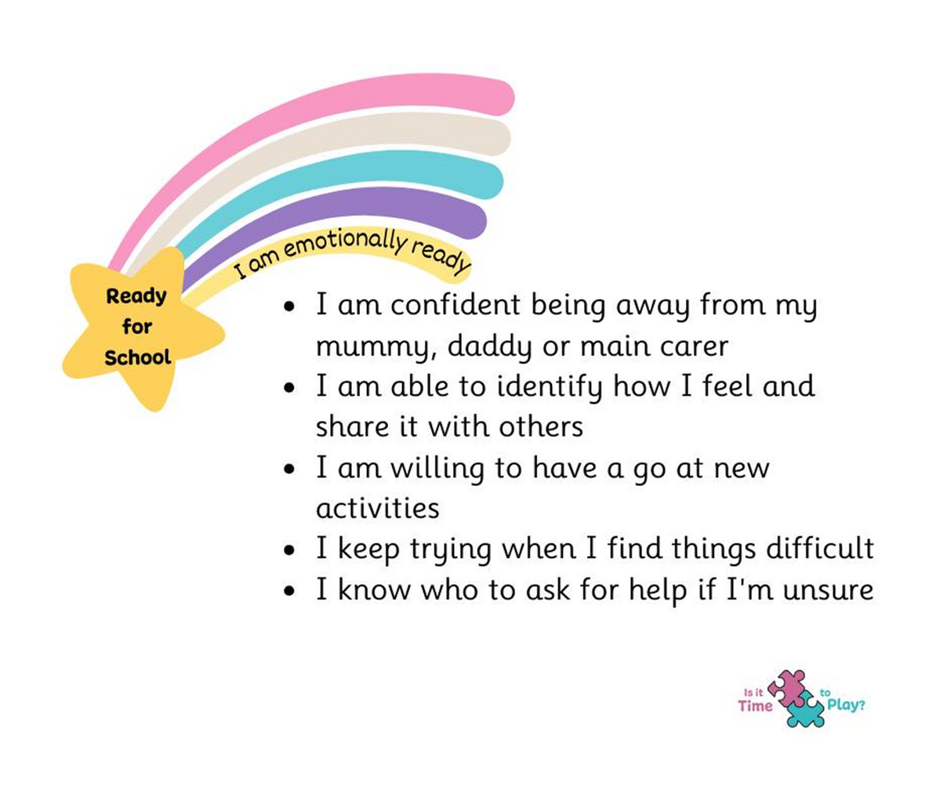

Slide 5
Supporting Emotional Readiness
Activities could include…
•Talk about emotions when your child feels them e.g I can see your feeling sad/frightened, anxious, worried, happy, excited, angry
•Talk about people at school who can help them if they need it
•Talk about school in a positive way
•Play turn taking games and practice winning … and losing!
•Model and encourage patience and waiting
•Walk to school/visit outside in the holidays to familiarise
the route/building.

Slide 6



Tom Percival

Slide 7
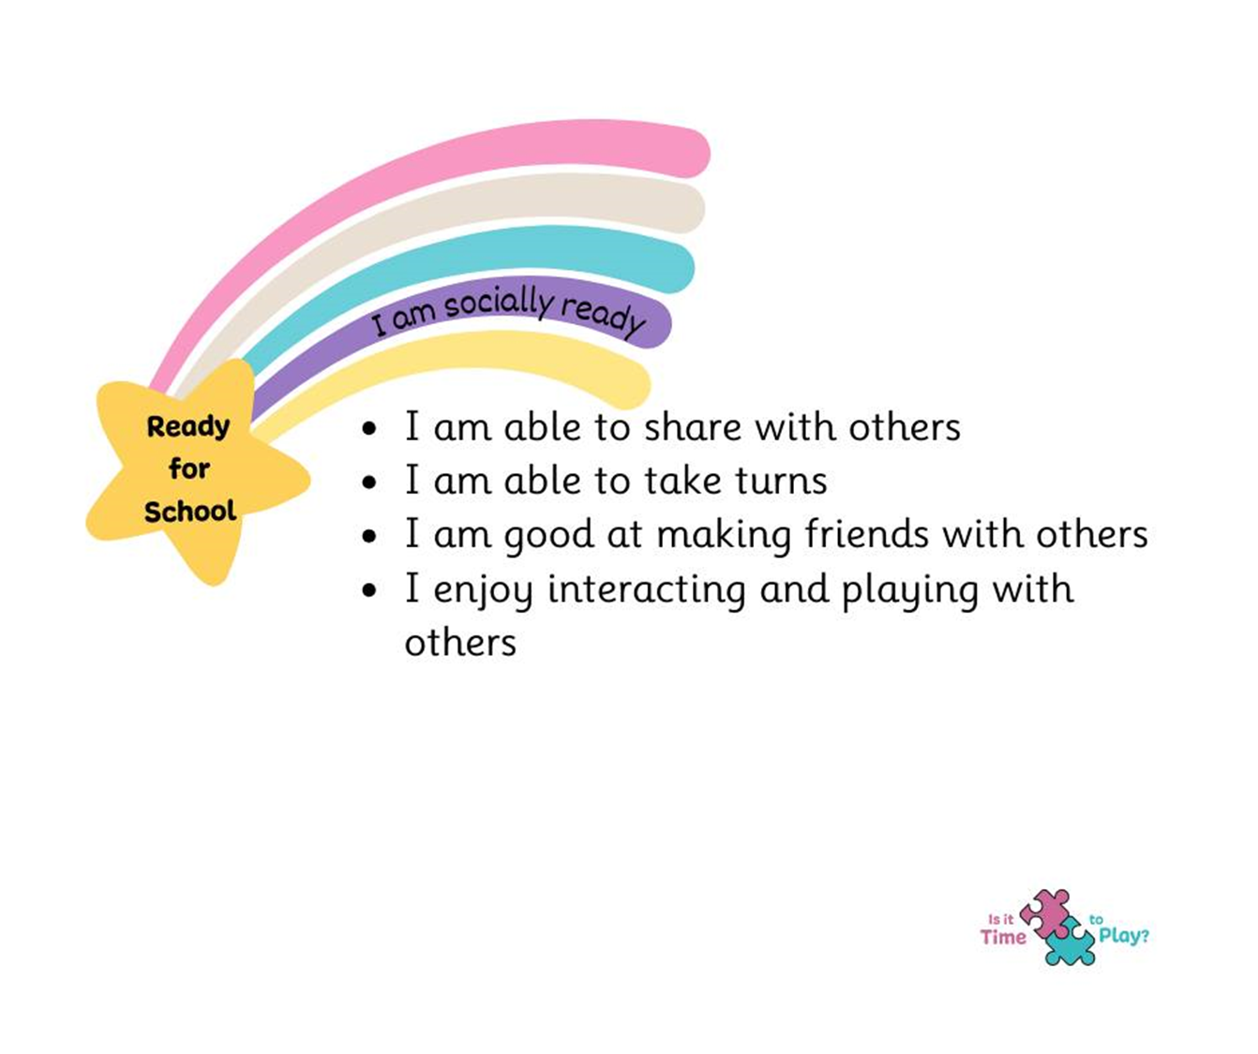

Slide 8
Supporting Social Readiness
Activities could include…
•Playdates in the holidays with people coming to the same school.
•Trips to the park/soft play – socialising with other children.
•Take turns and share by playing games like snakes and ladders, snap, dominos etc.
•Talk about what your child likes and dislikes.
•Practise phrases to help your child makes friends e.g Will you play with me? Can I play with you? Can you help me?
•Encourage your child to follow rules and boundaries at home and understand what they need to do in school – Be safe, Be ready, Be respectful.

Slide 9
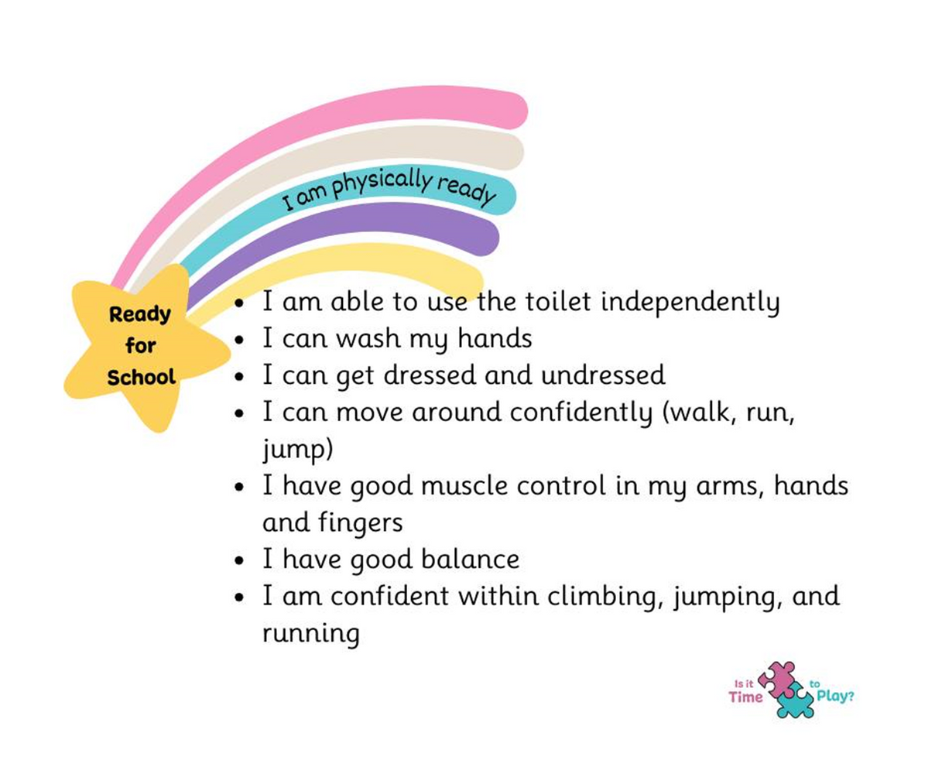

Slide 10
Fine Motor Skills
Activities could include…
•Practise holding a pencil, paintbrush, pen, chalk and making marks.
•Use scissors and practice cutting a straight line.
•Use playdough to build strength in hands and fingers.
•Thread pasta tubes onto string or straws.
•Trace lines and shapes in salt, flour, rice.
•Practise making anticlockwise motions in the air or with writing tools.
•Trace over simple shapes.
•Use tweezers to transfer an object.
•Dab and dot using cotton buds with paint.
•Squeeze sponges in water.
•Use small spoons to transfer objects like rice into a bowl.

Slide 11
Getting physically ready for school
Activities could include…
•Practise putting on school uniform.
•Practise putting on their own coat – flip method! (video link)
•Practise doing up their zip.
•Practise taking off shoes and socks and putting them back on again.
•Going to the toilet and wiping – children need to be able to do this themselves. If you need advice please seek early support from your health visitor or GP.

Slide 12
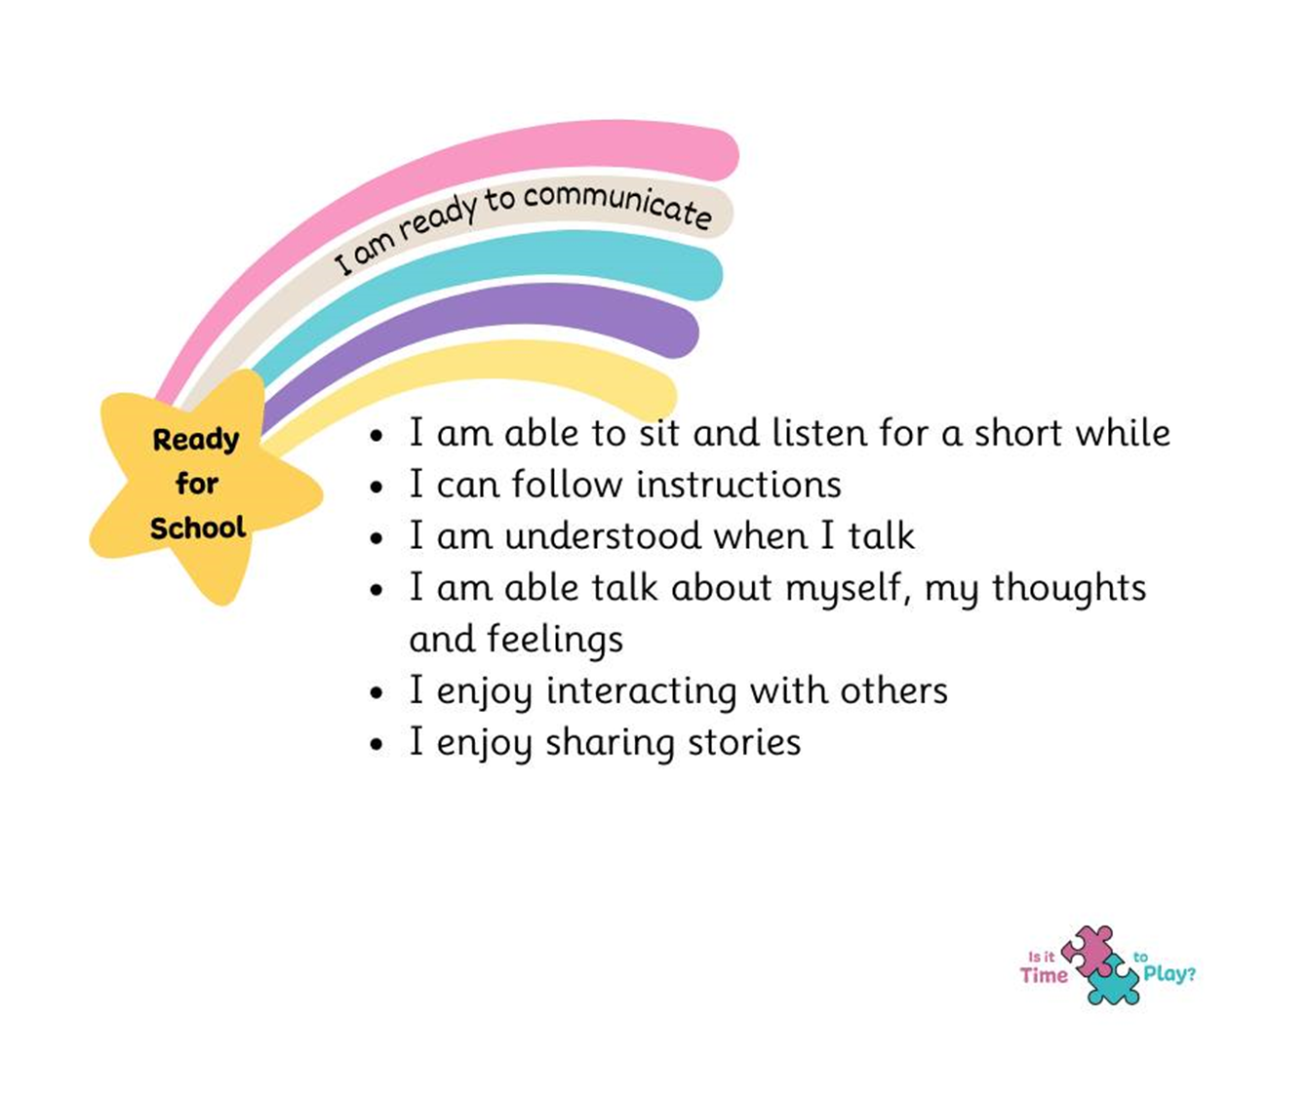

Slide 13
Getting Ready to Communicate at School
Activities could include…
•Give your child a two step instruction e.g. get your coat and then put it on.
•Read them stories and encourage them to listen attentively for 10 minutes.
•Encourage your child to wait when an adult is speaking to another adult, practise patience and waiting their turn to talk.
•Have conversations with your child and ask them questions.
•Reduce background noise from TV/music when talking to your child to develop attentive listening skills.
•If you have concerns about your child’s listening or speaking skills please share these with staff early on or seek advice from your health visitor or GP as early as possible.

Slide 14
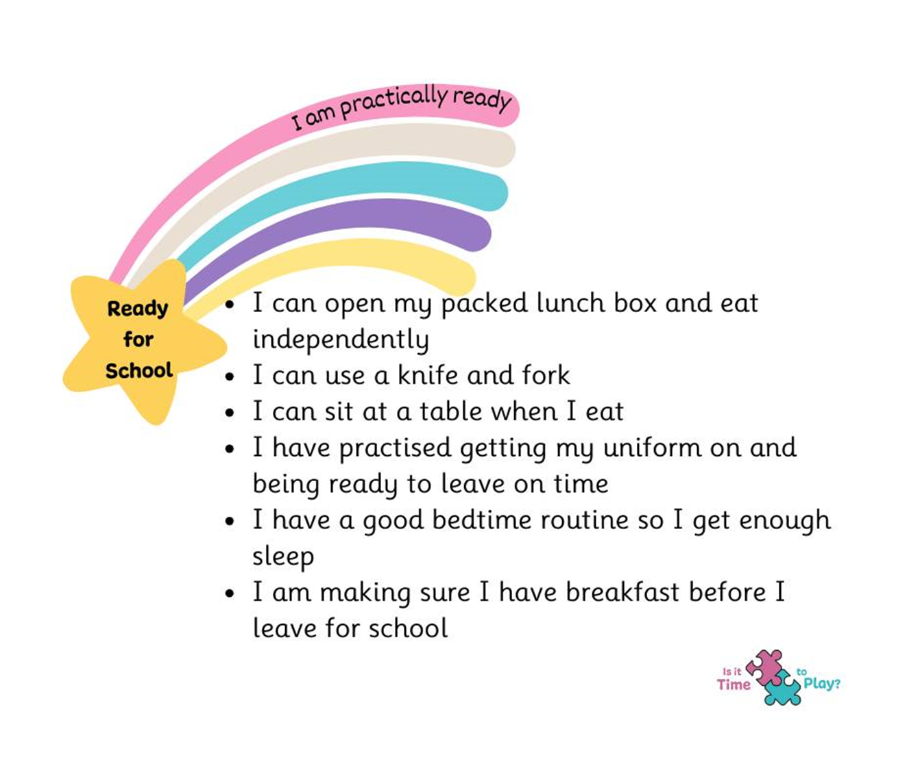

Slide 15
Getting ready to be independent and ready to learn at school
Activities could include…
•Show them their packed lunch box and practise opening packets by themselves
•Show them how to find their own bookbag/coat/lunchbox and practise putting things in and out of their bags.
•Encourage them to peel their own banana and satsuma, eat an apple whole.
•Practice using a knife and fork – make playdough food to “cut up”
•Practise scraping their plate into a bin
•Show them their uniform and name it clearly with name labels
•Have a good bedtime routine to support healthy brain development – 4 and 5 year olds typically need 10-11 hours of sleep a night.

Slide 16
Academic Extras
•Practise recognising their name when written down
•Practise copying or writing letters in their name with a capital letter to start and the following letters in lowercase
•Practise counting 0-10 out loud and counting with 1:1 correspondence (touching each object they count and saying a number for each)
•Practise using scissors to cut a straight line
•Practise reading a book together and tracking text from left to right
•Practise recognising numbers 0-10 by looking at door numbers, number plates etc
•Practise identifying initial sounds orally e.g sun begins with the sound sssss what else starts with s?
•Practise oral blending e.g can you get me your c-oa-t
•Sing nursery rhymes and songs together in the car
•Play “I spy” with initial sounds
•Practise drawing a simple person picture with all the features it needs.

Slide 17
Useful Websites
BBC Getting ready for school - https://www.bbc.co.uk/programmes/p05bvjjt
Coat flip video - https://www.youtube.com/watch?v=-FaxBoCvNqM
PACEY getting ready for school - https://www.pacey.org.uk/partners/school-ready/preparation/
Healthy screen use information - https://www.childnet.com/help-and-advice/screen-time-boundaries-parents/
CBC School Readiness document -
chrome-extension://efaidnbmnnnibpcajpcglclefindmkaj/https://www.centralbedfordshire.gov.uk/migrated_images/16-ticks-poster_tcm3-17284.pdf

Slide 18
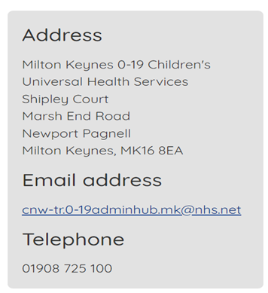

Any questions or queries – who can I contact?
If you have any concerns or queries about your child’s development, skills, home life or parenting support needs, please ask for help early so we can support you.
Kirsten Garratt (Pastoral Care) : k.garratt@swallowfieldprimary.com
Rebecca Millward (SEND) : r.millward@swallowfieldprimary.com
Contact Health Visitor

Slide 19
Next meeting/Diary Dates
  Reception Introduction Meeting – Tuesday 3rd June 5.00pm-6.00pm – parent meeting
  Stay and Play sessions – Wednesday 18th and Thursday 26th June 4.00-4.45pm – parents/carers and child to attend together.
  Transition Morning – Wednesday 2nd July 9.45am-11.00am – parents/carers to drop off and children stay with class teacher for the duration of the session.
  Home Visit – you will be emailed your date/time.

Slide 20
Thank You

