Slide 1
WELCOME TO YEAR 5
SWALLOWFIELD PRIMARY SCHOOL
Weathercock Close, Woburn Sands,
Milton Keynes, Bedfordshire MK17 8SR
www.swallowfieldlowerschool.co.uk
3/7/19

Slide 2
OUR VISION & MISSION STATEMENT
We will provide a safe, inclusive and stimulating environment where every child builds the confidence to become a lifelong learner.
Support. Inspire. Nurture. Achieve
Support. Inspire. Nurture. Achieve
Swallowfield Primary School

Slide 3
OUR VISION & MISSION STATEMENT
Year 5
Same Vision
Same Mission
This is an evolution not a revolution…….
Support. Inspire. Nurture. Achieve
Swallowfield Primary School

Slide 4
Support. Inspire. Nurture. Achieve
Swallowfield Primary School
Notes:
Not sure what you want to put here – new structure?
Details of teaching staff?

Slide 5
YEAR 5
Quality education and academic success
Nurture and develop the whole child
Building on established relationships and support networks
Provision of unique experiences
Support. Inspire. Nurture. Achieve
Swallowfield Primary School

Slide 6
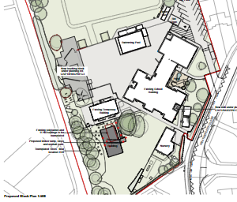
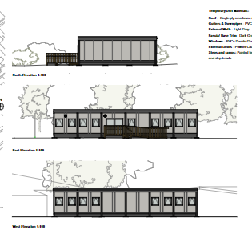
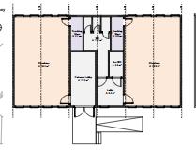
YEAR 5 BUILDINGS
TEMPORARY STRUCTURE
Support. Inspire. Nurture. Achieve
Swallowfield Primary School

Slide 7
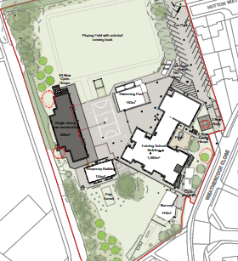
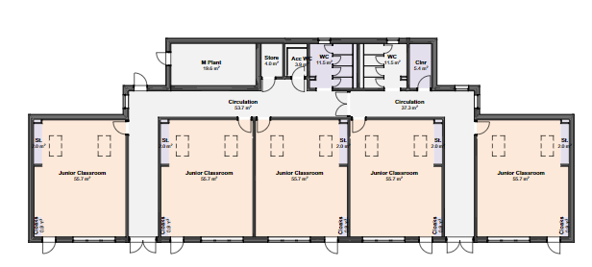
YEAR 5 BUILDINGS
NEW KS2 BUILDINGS
Support. Inspire. Nurture. Achieve
Swallowfield Primary School

Slide 8
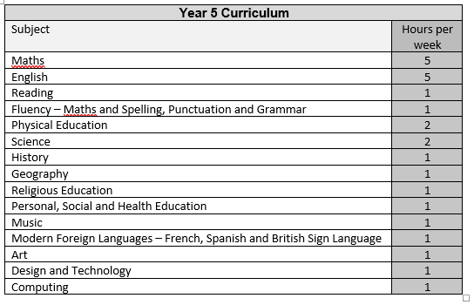
YEAR 5
CURRICULUM
Support. Inspire. Nurture. Achieve
Swallowfield Primary School

Slide 9
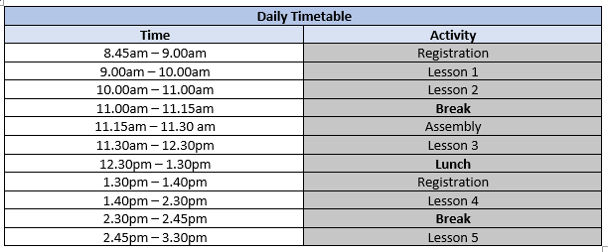
YEAR 5
TIMETABLE
Support. Inspire. Nurture. Achieve
Swallowfield Primary School

Slide 10
YEAR 5
ORGANISATION AND ROUTINES
Enter and exit using the Busy Bees gate
Parents to drop off and collect children
Specific PE days
Uniform as specified in revised uniform requirements on the school website
Communication via SchoolPing and email
Expectations remaining the same
Support. Inspire. Nurture. Achieve
Swallowfield Primary School

Slide 11
YEAR 5
HOMEWORK
Building independent learning skills
Consolidating learning in class
Set on Google Classrooms
Weekly spellings
Maths fluency
One piece of maths and written homework every week.
Support. Inspire. Nurture. Achieve
Swallowfield Primary School

Slide 12
YEAR 5
EXTRA-CURRICULAR
Continue to enhance existing opportunities
Additional before and after school activities
Homework
Support. Inspire. Nurture. Achieve
Swallowfield Primary School

Slide 13
YEAR 5
RESPONSIBILITIES
House captains/Head Boy/Head Girl
Anti-bullying Ambassadors
Library
Sports Leaders
Mentors
Support. Inspire. Nurture. Achieve
Swallowfield Primary School

