Slide 1

Addition
Subtraction
Teaching Maths at Swallowfield
30/10/19
Parents and Carers Meeting

Slide 2
Mathematics Curriculum 2014
Three aims of the National Curriculum:
Fluency – Reasoning – Problem Solving
We follow a mastery based curriculum in Maths.
Government approach to improve Maths teaching and learning in UK.

Slide 3



Pisa Results
Measures the mathematical literacy for 15 year olds every 4 years
Singapore-1st
Hong Kong, China-2nd
Myth: The curriculum is largely focused on rote learning and practise.
Fact: Understanding and skills are equally important.
United Kingdom-22nd

Slide 4

Primary Mastery Specialists
Supporting other schools in their Maths teaching.
Advise on teaching strategies through a mastery based approach.

Slide 5
Achieving Mastery
A longer time is spent on one idea, small steps in learning leading to depth.
Effective teacher questioning is used to challenge thinking.
Whole class interactive teaching with active learning tasks. Real life challenges.
A set structure that flows through each part of the lesson-exploring potential misconceptions along the way.
Same day intervention occurs.
The ability to reason about a concept and make connections.

Slide 6
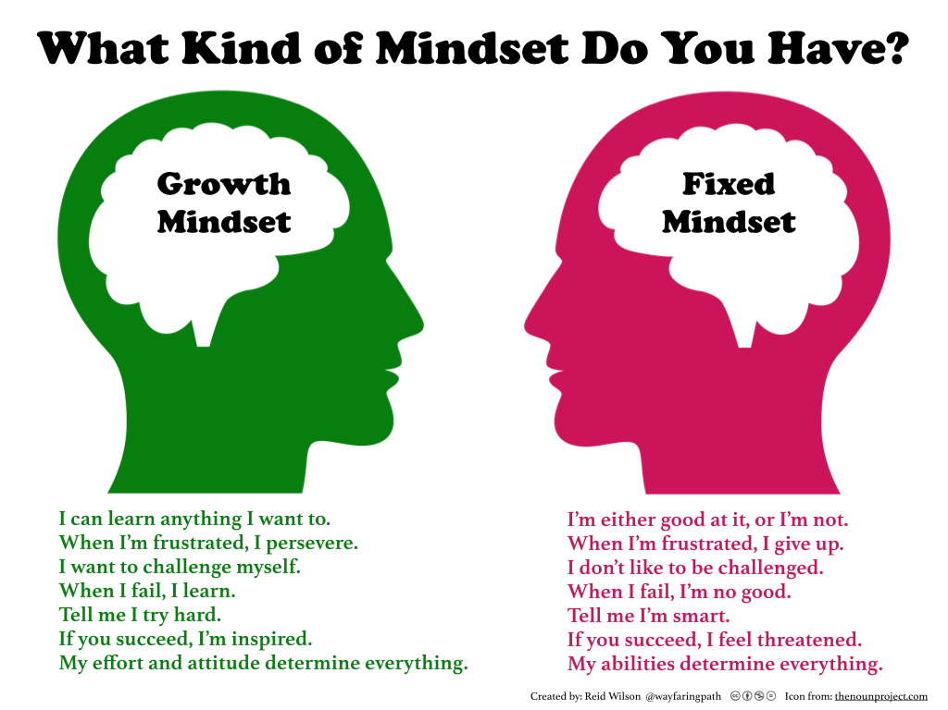
Growth Mindset
It has become acceptable in society to be 'bad at Maths'. We need to find ways to actively encourage a positive growth mindset in our children.

Slide 7
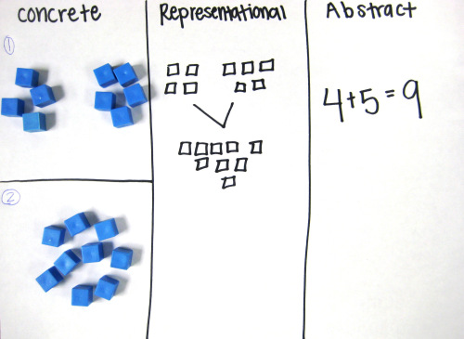
We follow a ‘CPA’ approach
Concrete representation
A pupil is first introduced to an idea or a skill
by acting it out with real objects. This is a 'hands on' component using real objects and it is the foundation for conceptual understanding.
Pictorial representation
A pupil has sufficiently understood the hands-on experiences performed and can now relate them to representations, such as a picture of the problem.
Abstract representation
A pupil is now capable of representing problems by using mathematical notation, for example: 4 + 5 = 9

Slide 8
Addition
Central Bedfordshire Calculation Policy
EYFS | Year 1 | Year 2 | Year 3 | Year 4
-Combing sets-Count all then count on -Partitioning sets-some ‘Part, Part Whole’ -To use a number line practically to add -Use numbers to represent objects, to begin to record | -Combining two parts to make a whole -Part Whole Model -Starting at the bigger number and counting on -Regrouping to make 10 | -Adding three single digits -Partitioning -Start of column method- no regrouping- some exchange | -Column method with regrouping (up to 3 digits) Expanded and compacted methods | -Column method with regrouping (up to 4 digits) Expanded and compacted methods

Slide 9
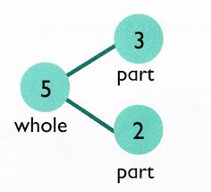
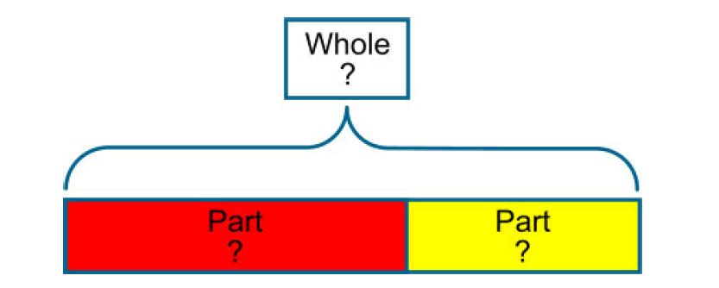
Go to Methods with TfM…

Slide 10
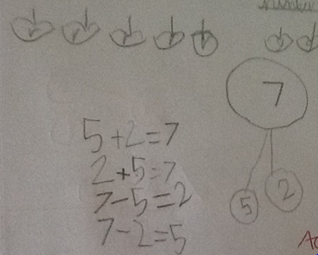
‘Part Part Whole’ Model
5 apples
and
2 apples?

Slide 11
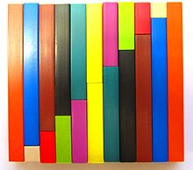
The Bar Model
7
2
5
7
1.9
5.1
7.4
C
1.7
5.7
a
b

Slide 12
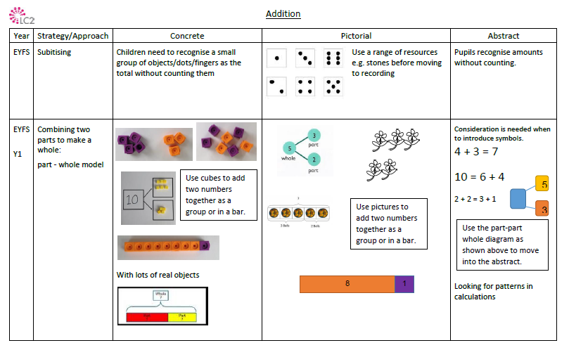

Slide 13
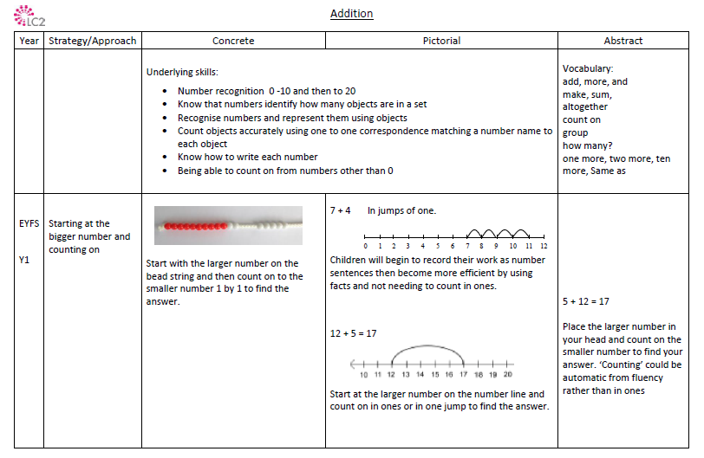

Slide 14
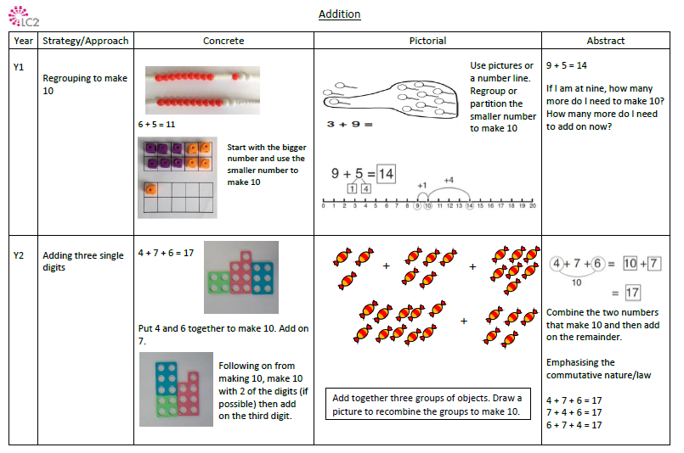

Slide 15
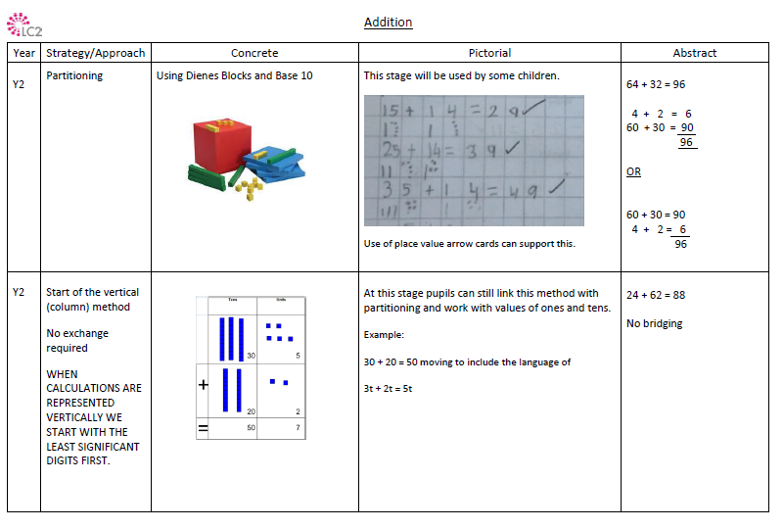

Slide 16
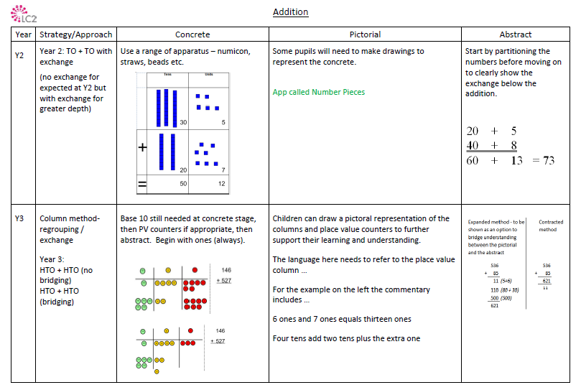

Slide 17
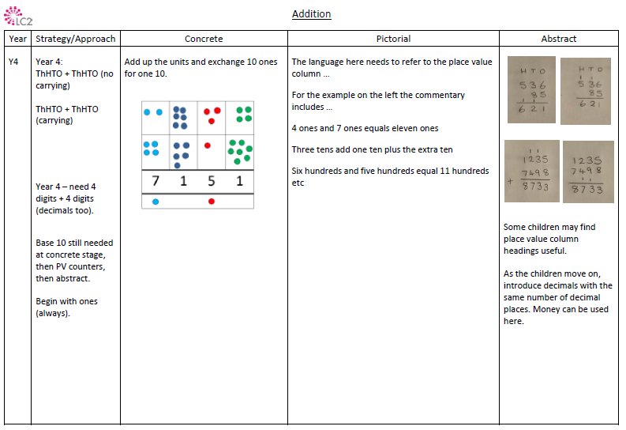

Slide 18
Models for addition
EYFS examples
Combining two sets of objects (aggregation)
5
7
12
Adding on to a set (augmentation)
12

Slide 19
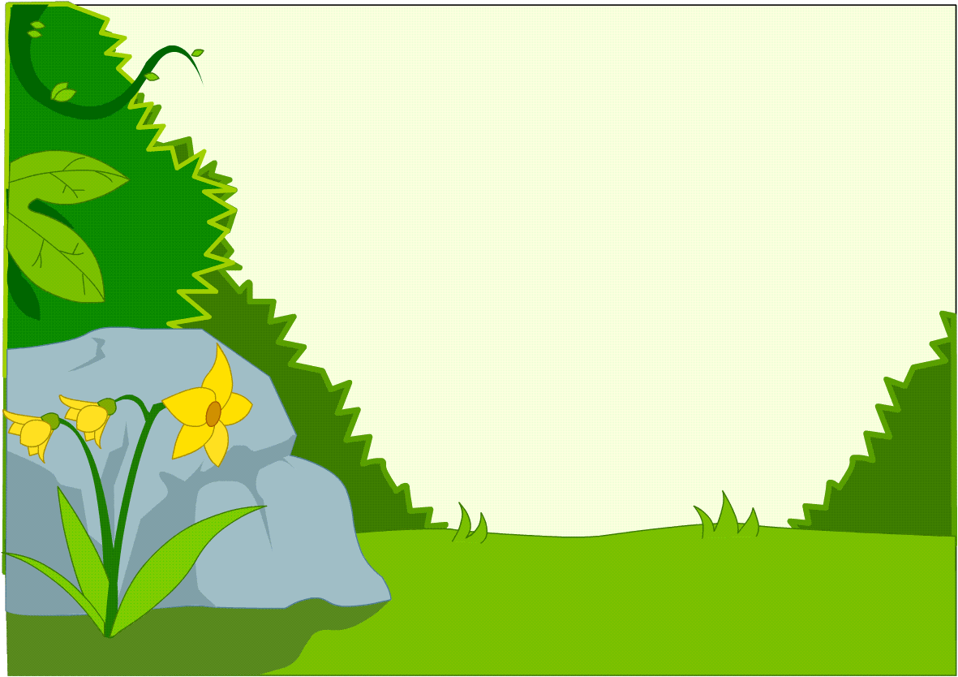
Y1/Y2 examples
Bridging to
the next10

Slide 20
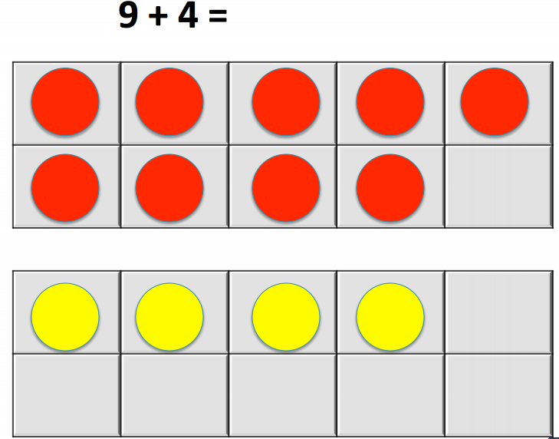

Slide 21

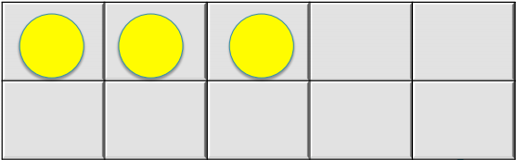


Slide 22
13
9 + 4 =
10 + 3 = 13
1
3

Slide 23

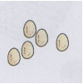



Slide 24
32
27 + 5 =
30 + 2 = 32
3
2

Slide 25
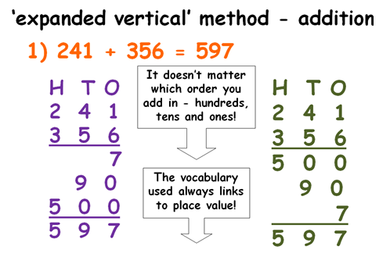
Y3/Y4 examples

Slide 26
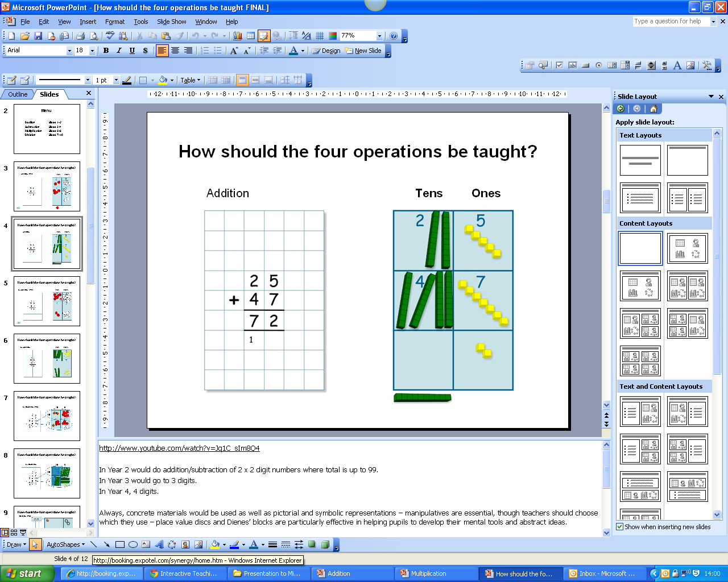
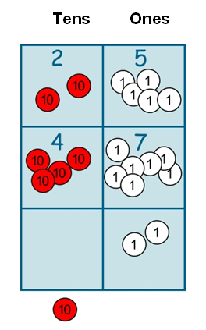

Compacted method
leading to
Notes:
26
26

Slide 27
Subtraction
Central Bedfordshire Calculation Policy
EYFS | Year 1 | Year 2 | Year 3 | Year 4
-Partitioning- physically taking away objects -To use a number line practically to subtract -Use numbers to represent objects, to begin to record | -Taking away ones -Counting back Find the difference -Part Whole model -Make 10 | -Counting back, counting on -Find the difference, Part Whole model, make 10 - Start of column method- no regrouping- some exchange | -Column method with regrouping (up to 3 digits) | -Column method with regrouping (up to 4 digits)
CPA Approach

Slide 28
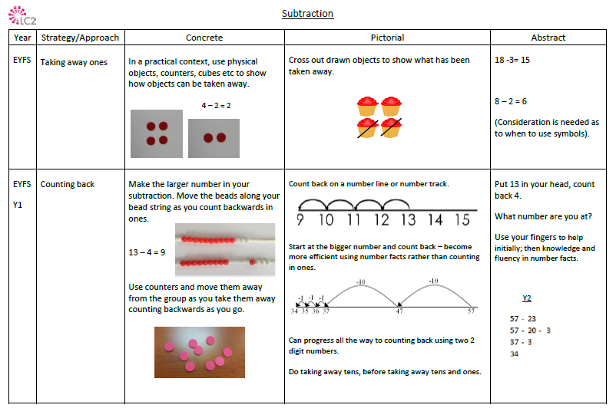

Slide 29
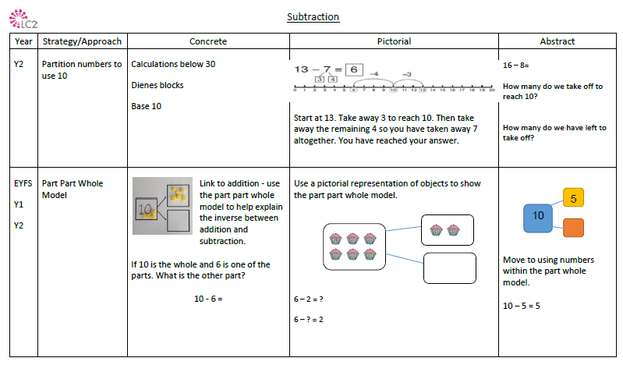

Slide 30
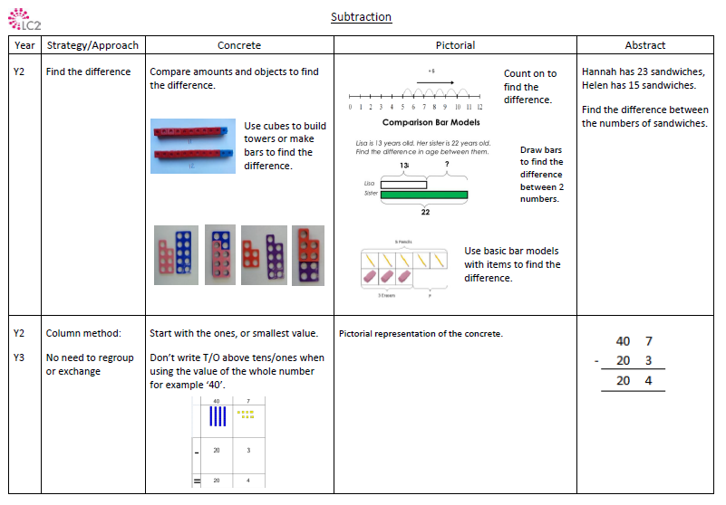

Slide 31
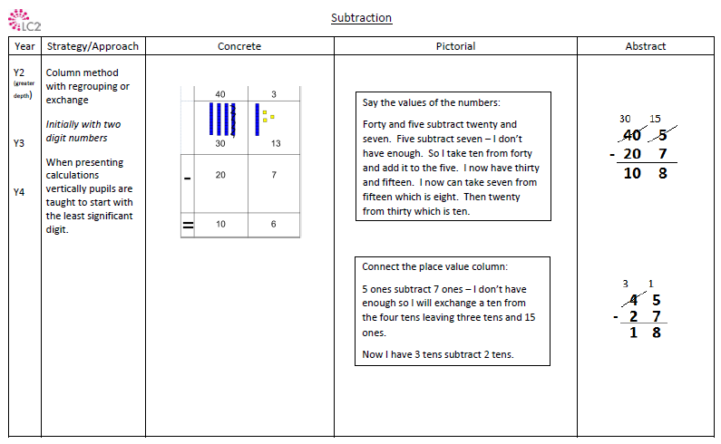

Slide 32
Models for subtraction
EYFS/Y1 examples
Removing items from a set (reduction or take-away)
Issue:
Relies on ‘counting all’, again.
12
- 1
7
- 2
- 3
- 4
- 5
=
Comparing two sets (comparison or difference)
Useful when two numbers are ‘close together’, where ‘take-away’ image can be cumbersome
Seeing one set as partitioned
Seeing 12 as made up of 5 and 7
Helps to see the related calculations; 5+7=12, 7+5=12, 12-7 = 5 and 12-5=7 as all in the same diagram

Slide 33
Models for subtraction
Y2 examples
Counting back on a number line 12-5
Knowledge of place value and number bonds can support more efficient calculating
- 5
Number line helps to stop ‘counting all’.
0
7
-3
10
-2
12
Finding the difference on a number line
7
Useful when two numbers are ‘close together’, use of number bonds and place value can help.
0
5
5
10
2
12

Slide 34
More than single digits?
Y2/Y3/Y4 examples
72 - 47
This is now “Sixty-twelve”
7 ¹2
6
Notes:
34

Slide 35
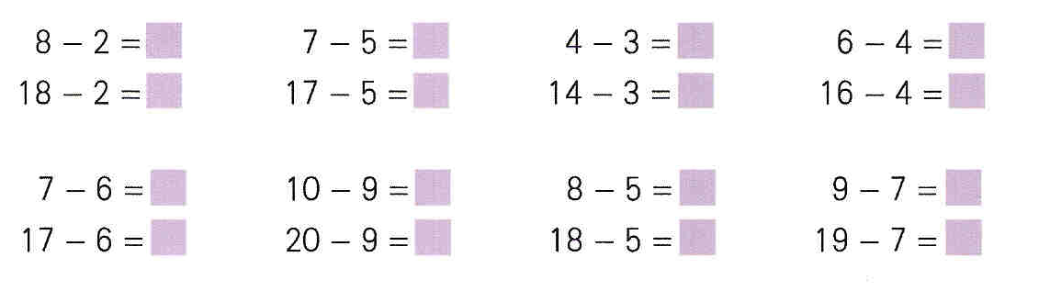
Variation

Slide 36
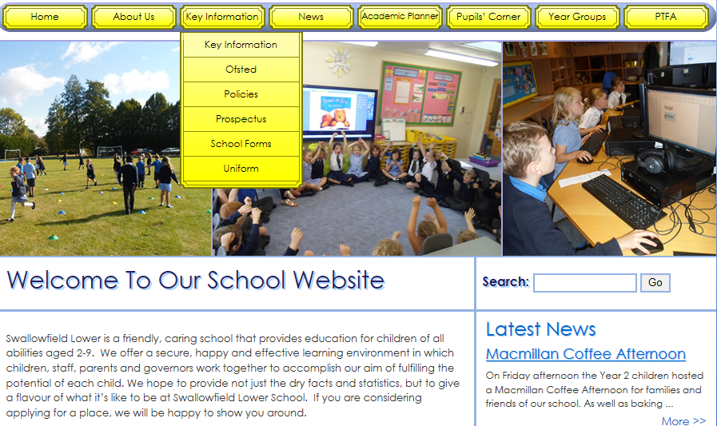
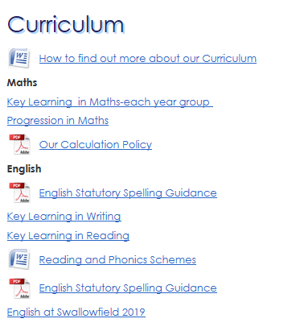
Our Calculation Policy
If you would like to find out more…

Slide 37
The Answer is only the beginning………..
The teacher presents a maths problem and then asks:
Describe the method/procedure you used
Why does the method work, what relationships are involved, what generalities or rules can we glean?
What is the answer?

Slide 38
How can you help?
Questioning
This can be done simply by asking children to explain how they worked out a calculation or solved a problem, and to compare different methods.
Fluency Drive
Support your child with their:
  -Number bonds;
  -Multiplication and division facts;
  -Inverses.

Slide 39
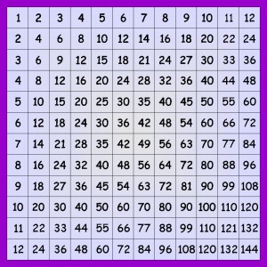

How can you help?
Fluency Drive
Multiplication Facts – end of Year 4
5 minute online activity
12 x 12

Slide 40
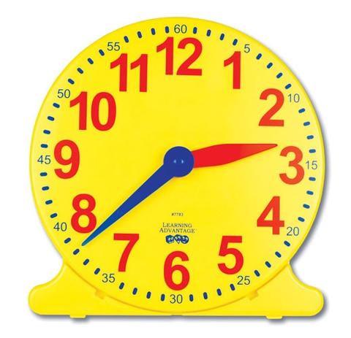
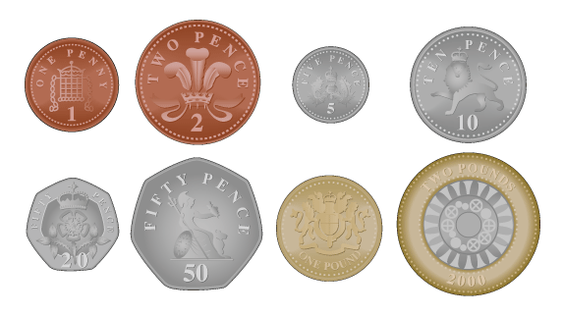

Top tips for parents!
Be positive about maths. Try not to say things like "I can’t do maths" or "I hated maths at school" - your child may start to think like that themselves.
Point out the maths in everyday life. Include your child in activities involving numbers and measuring, such as shopping, cooking and travelling.
Praise your child for effort rather than for being "clever". This shows them that by working hard they can always improve.

Slide 41
Any Questions?

